Slide 1


Dataset development for repeated high-energy shock of electronic assemblies
Joud N. Satme
Trotter Roberts
Austin R.J. Downey
Department of Mechanical Engineering
Notes:
1

Slide 2
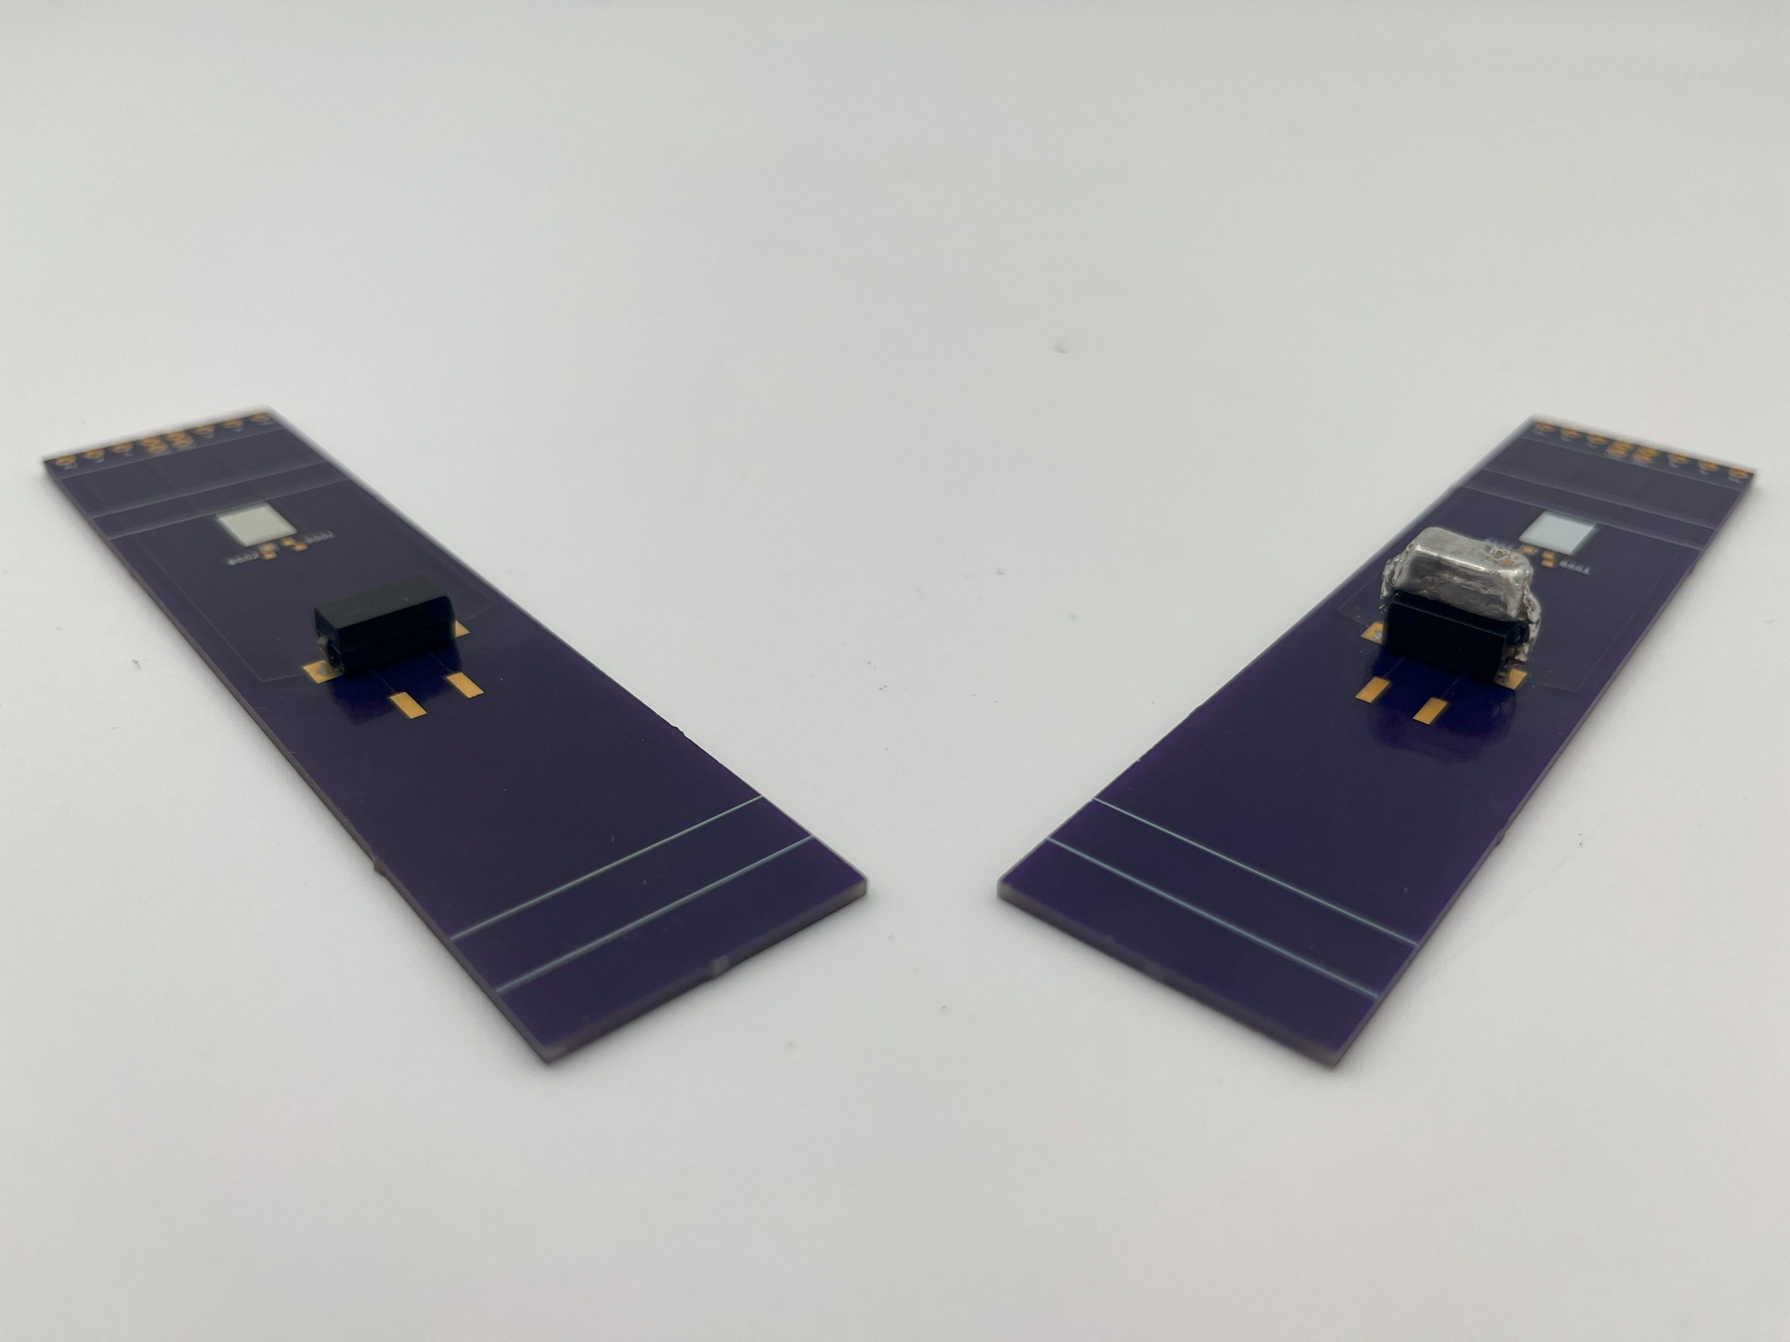
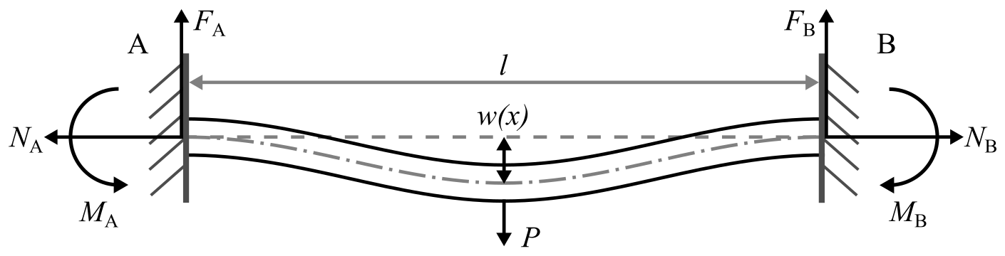
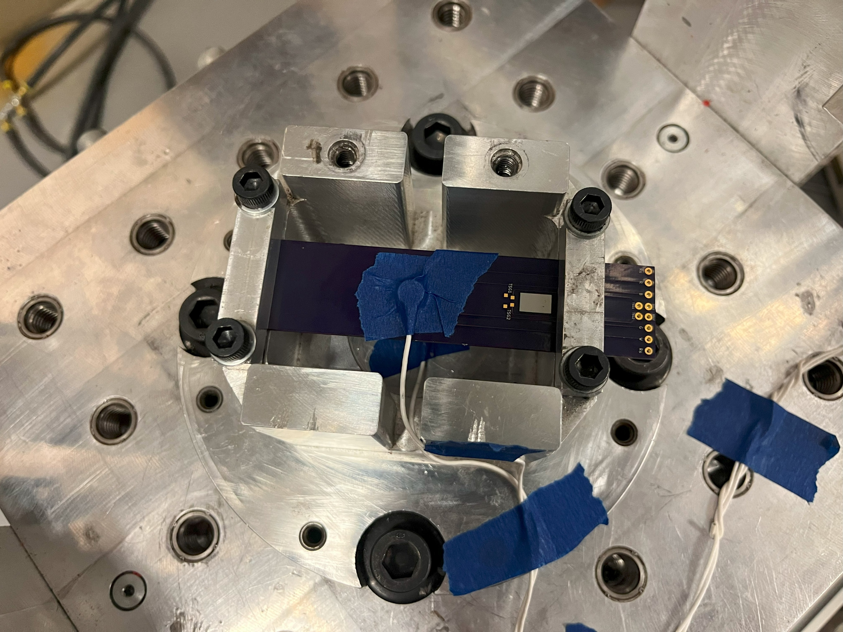
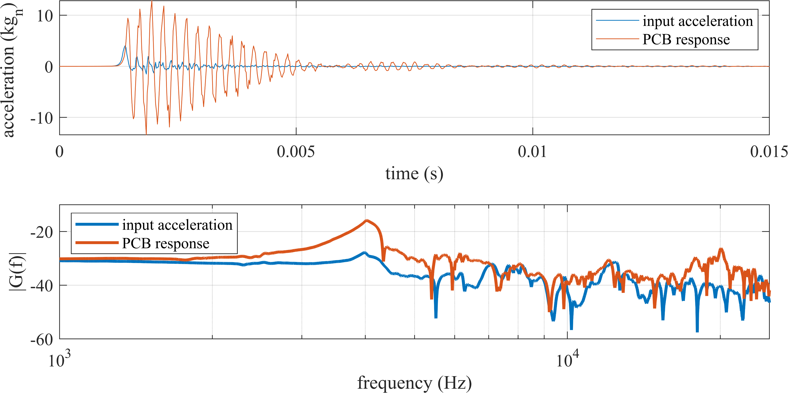
Dataset
Dataset consists of acceleration and resistance measurements taken at repeated shock events
Each test consists of 20000 samples of acceleration sampled at 200000 S/s
One resistance measurement is taken per shock event
A neural network model will predict the resistance value given the acceleration signal

Slide 3
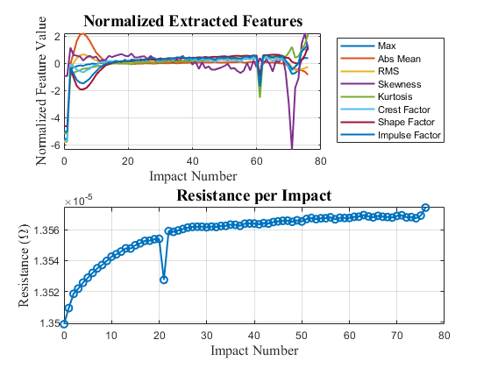
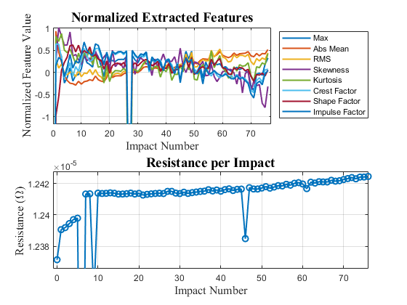
Dataset
Dataset consists of acceleration and resistance measurements taken at repeated shock events
Each test consists of 20000 samples of acceleration sampled at 200000 S/s
One resistance measurement is taken per shock event
A neural network model will predict the resistance value given the acceleration signal
Training parameters
Adam optimizer
Epochs: 10000
Mini batch size: 25
Initial learn-rate: 1e-5
Gradient threshold: 0.1

Slide 4
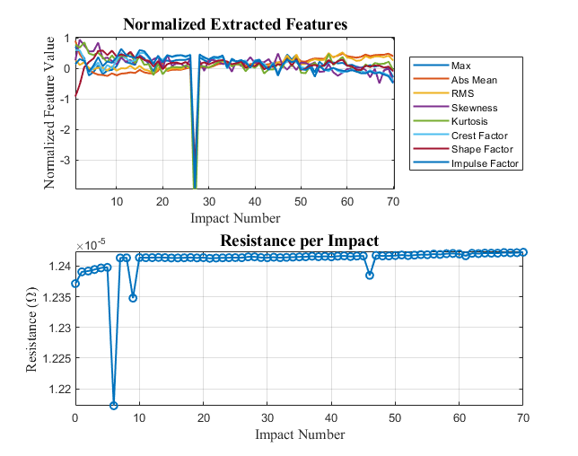
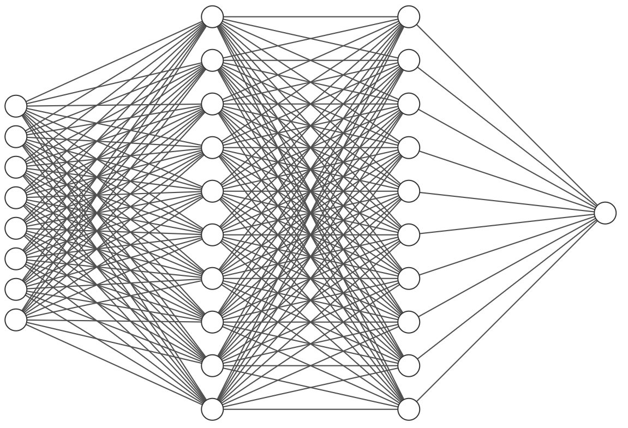
Neural Network Architecture
10-neuron
hidden layer
10-neuron
hidden layer
feature inputs
resistance
output

Slide 5
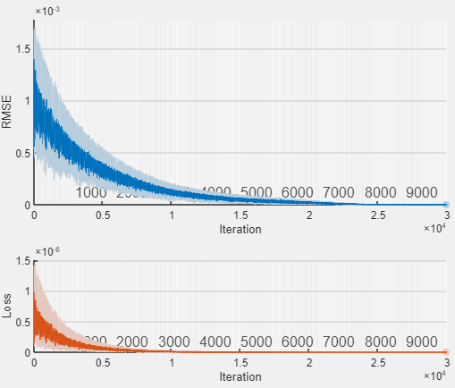
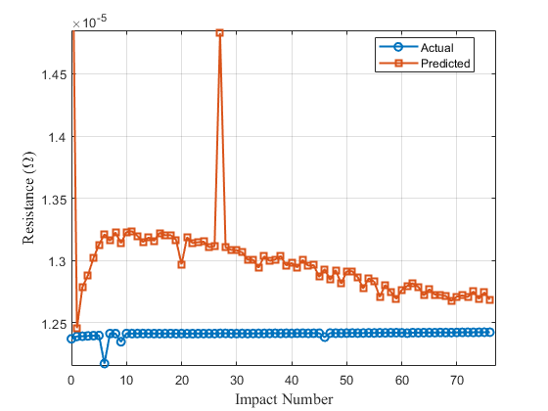
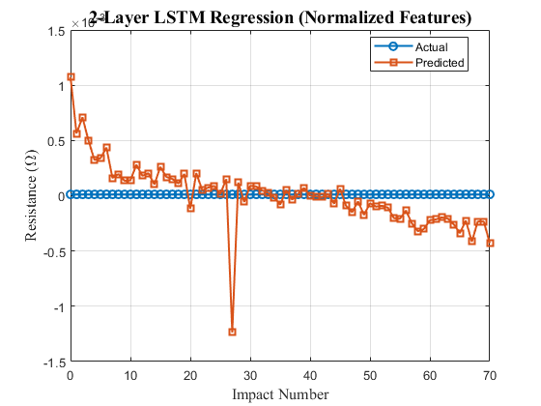
Results of Training & Validation

Slide 6

Practical Considerations for Deployment
Major challenge: Model generalizability over different PCB configurations and electronic assemblies
Timing constraints: Governed by the high-rate dynamic regime
Footprint and computation: Finding the sweet spot between accuracy, computational load, and latency

Slide 7
Thanks!
Joud satme
Health-State Classification of Printed Circuit Boards Under High-Energy Shock Using an LSTM
Jsatme@emial.sc.edu

